Slide 1
UNIT II – SDN Devices and Controller
UNIT I – SESSION 1
SESSION 4
Nicira
VMware/Nicira
Reference: Ref. 2, Ch.4 (Page. 79 to Page 83)

Slide 2
Nicira
Nicira was founded in 2007 and is considered a later arrival to the SDN marketplace than VMware.
Nicira’s network virtualization platform (NVP) was released in 2011
NVP now works in conjunction with the other cloud virtualization services for compute, storage, and image management
It used overlay networks (e.g., VXLAN) to encapsulate and tunnel traffic over the existing physical network infrastructure.
NVP works with Open vSwitch (OVS)
OVS
  Open vSwitch (OVS) is an open-source, multi-layer virtual switch and is designed to provide high-performance, programmable switching capabilities for virtualized and containerized network environments.
  Open vSwitch operates as a virtual switch within hypervisor environments, allowing it to connect virtual machines (VMs), containers, and physical network interfaces.
https://www.youtube.com/watch?v=a1Ug9VomSvM

Slide 3
Nicira
Nicira only uses OpenFlow to a small degree. which enables centralized control and programmability of network switches and routers. OpenFlow played a crucial role in Nicira's approach to network virtualization.
Most of the programming of OVS is achieved with a database-like protocol called the Open vSwitch Data Base Management Protocol (OVSDB).
OVSDB provides a stronger management interface to the hypervisor switch/element for programming tunnels,

Slide 4
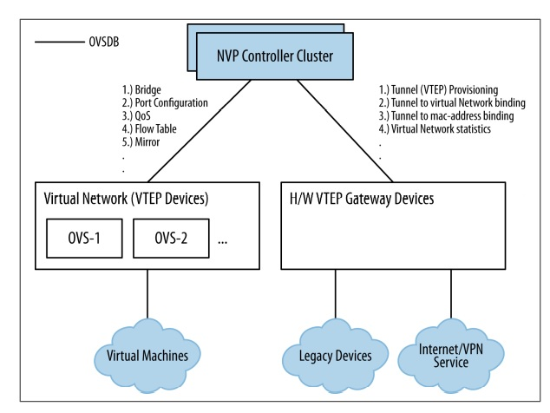
Nicira NVP Controller

Slide 5
Nicira NVP Controller
The Nicira Network Virtualization Platform (NVP) Controller is a core component of Nicira's network virtualization solution, which provides advanced network control and management capabilities.
The Nicira NVP controller is a cluster of generally three servers that use database synchronization to share state.
Nicira has a service node concept that is used to offload various processes from the hypervisor nodes.

Slide 6
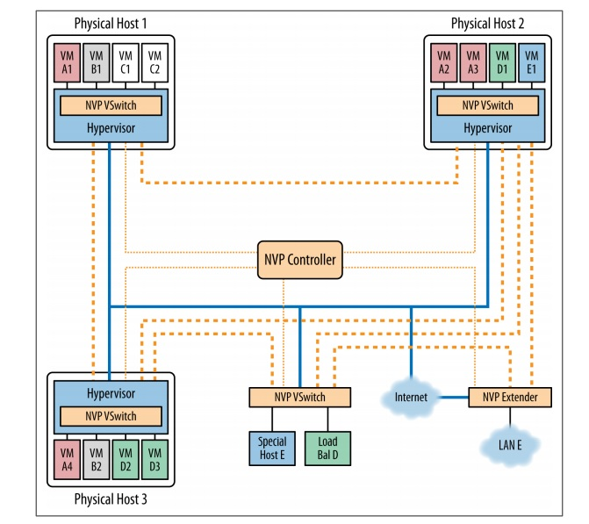
NVP Component Relationship

Slide 7
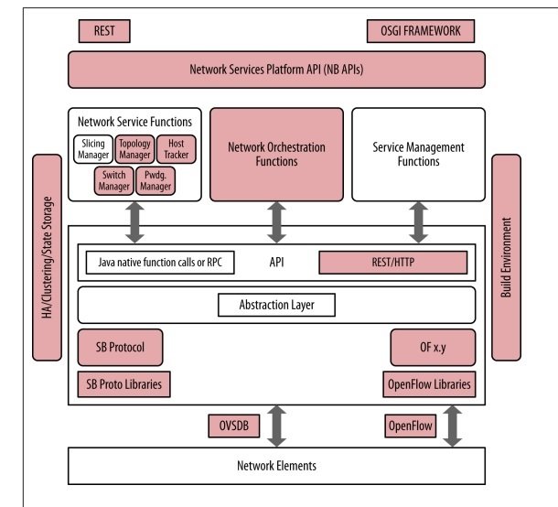
Relationship of VMware / Nicira controller’s components to the idealized SDN framework

Slide 8
Nicira NVP Controller
Nicira controller provides
  a variety of RESTful northbound programmable APIs,
  network orchestration functions in the way of allowing a user to create a network overlay
  And link it to other management elements from vCenter/vCloudDirector, VxLAN, STT and OpenFlow southbound encapsulation capabilities
  OVSDB programmability in support of configuration of southbound OVS entities.

Slide 9
VMware/Nicira
Both Nicira and VMware products provide proprietary northbound application programming interfaces and use proprietary southbound interfaces/protocols that allow for direct interaction with network elements both real and virtual.
Nicira supports an OpenStack plug-in to broaden its capabilities in data center orchestration or resource management.

Slide 10
UNIT II – SDN Devices and Controller
UNIT I – SESSION 1
SESSION 5
OpenFlow-Related
Mininet
NOX/POX
Reference: Ref. 2, Ch.4 (Page. 83 to Page 89)

Slide 11
Open Flow Related
Most open source SDN controllers revolve around the OpenFlow protocol due to having roots in the Onix design (Onix is a distributed control platform designed for SDN) (Ref Figure),
Unlike the VMware/Nicira solution or the L3VPN/PCE solutions that follow, OpenFlow solutions don’t require any additional packet encapsulation or gateway.
Although hybrid operation on some elements in the network will be required to interface OpenFlow and non-OpenFlow networks.
the open source OpenFlow controller solutions use memory resident or in-memory databases for state storage.

Slide 12
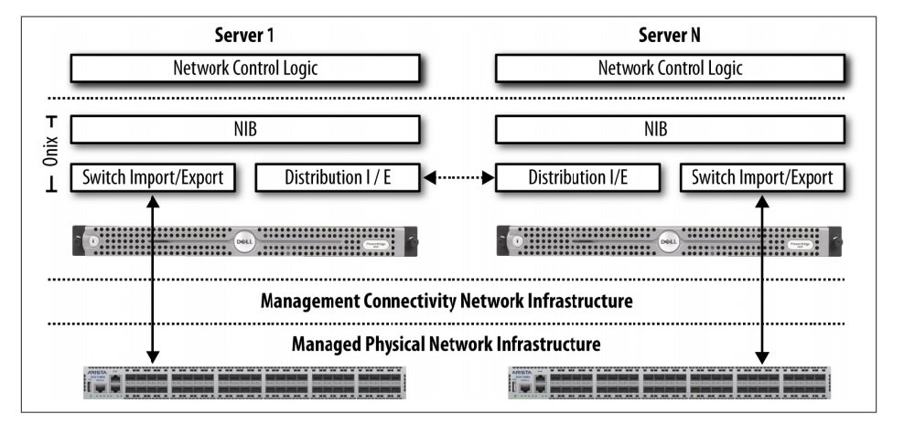
Onix Controller Model

Slide 13
Relationship to the ideal SDN Framework
Since most controllers have been based on the Onix code and architecture, they all exhibit similar relationships to the idealized SDN framework.
The Onix controller model first relates to the idealized SDN framework in that it provides a variety of northbound RESTful interfaces.
These can be used to program, interrogate, and configure the controller’s numerous functions, such as basic controller functionality, flow and forwarding entry programming, and topology.
All of these controllers support some version of the OpenFlow protocol up to and including the latest 1.3 specification,
All Onix-based controllers utilize in-memory database concepts for state management.

Slide 14
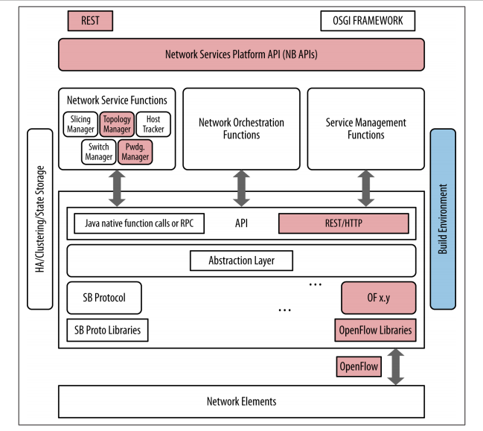
Onix Capabilities

Slide 15
Mininet
Mininet is an open-source network emulator used primarily for developing, testing, and experimenting with networking software, protocols, and applications. It allows users to create virtual networks of hosts, switches, controllers, and links on a single machine, providing a realistic environment for network testing without the need for physical hardware.
It uses lightweight virtualization to make a single system look like a complete network, running the same kernel, system, and user code.
Mininet is important to the open source SDN community as it is commonly used as a simulation, verification, testing tool, and resource.
Mininet is an open source project hosted on GitHub. (check out the freely available source code, scripts, and documentation).
https://www.youtube.com/watch?v=jmlgXaocwiE

Slide 16
Mininet
In this way, a Mininet host represents a shell of a machine that arbitrary programs can be plugged into and run.
These custom programs can send, receive, and process packets through what to the program appears to be a real Ethernet but is actually a virtual switch/interface.
Packets are processed by virtual switches, which to the Mininet hosts appear to be a real Ethernet switch or router, depending on how they are configured.
The measured performance of a Mininet-hosted network often should approach that of actual (non emulated) switches, routers, and hosts.
https://www.youtube.com/watch?v=cuej8DaQOwk

Slide 17
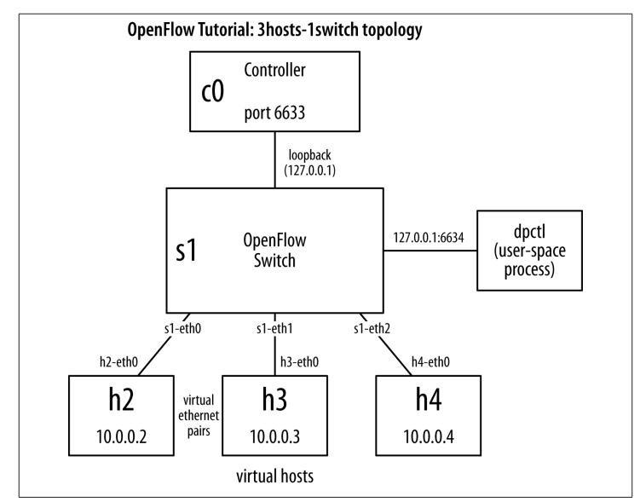
Mininet Network
A simple Mininet network comprised of three hosts, a virtual Open‐ Flow switch, and an OpenFlow controller.

Slide 18
NOX
NOX and POX are two early controllers
NOX was developed by Nicira and donated to the research community and hence becoming open source in 2008.
One of the first open source OpenFlow controllers
It provided a programmable framework for controlling network devices and orchestrating network behavior in SDN environments.
NOX provides a C++ API to OpenFlow (OF v1.0) and an asynchronous, event-based programming model.
NOX exposed a Python API that allowed developers to write network control applications using the Python programming language.
NOX is both a developing controller and a component-based framework for developing SDN applications. .
https://www.youtube.com/watch?v=5L4CnbVkeoU
https://www.youtube.com/watch?v=ZeJKF5y7uFM

Slide 19
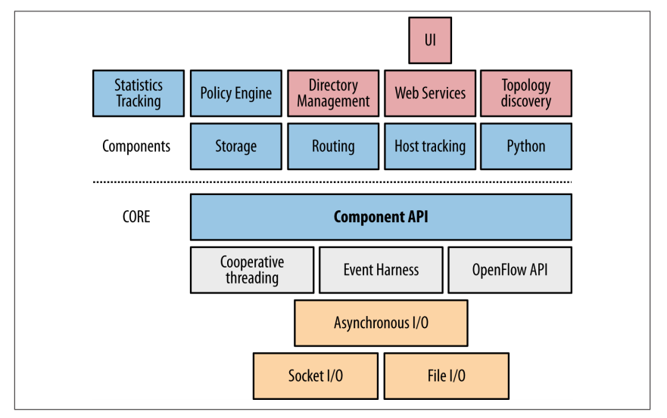
NOX
Additional components that leverage that API are available, including host tracking, routing, topology (LLDP), and a Python interface implemented as a wrapper for the component API, as shown in Figure.

Slide 20
NOX
NOX is often used in academic network research to develop SDN applications such as network protocol research.
NOX was used for implementing traffic engineering algorithms such as load balancing, path optimization, and congestion avoidance.
NOX was used for orchestrating network behavior in data centers, campus networks, and cloud environments. It allowed administrators to automate network configuration,
Some popular NOX applications are SANE and Ethane.
SANE is an approach to representing the network as a filesystem.
Ethane is a Stanford University research application for centralized, network-wide security at the level of a traditional access control list.

Slide 21
POX
Advantages of POX over NOX:
• Pythonic OpenFlow interface.
• Reusable sample components for path selection, topology discovery, and so on.
• POX runs anywhere and can be bundled with install-free PyPy runtime for easy deployment.
• POX specifically targets Linux, Mac OS, and Windows.
• POX supports the same GUI and visualization tools as NOX.
• POX performs well compared to NOX applications written in Python.
POX is the newer, Python-based version of NOX (or NOX in Python).
It serves as a lightweight and flexible platform for experimenting with SDN concepts, protocols, and applications.
It has a high-level SDN API including a query-able topology graph and support for virtualization.
https://www.youtube.com/watch?v=5L4CnbVkeoU
https://www.youtube.com/watch?v=KfPDRlt5lWM

Slide 22
UNIT II – SDN Devices and Controller
UNIT I – SESSION 1
SESSION 6
Trema
Ryu
Big Switch Networks/Floodlight
Reference: Ref. 2, Ch.4 (Page. 89 to Page 95)

Slide 23
Trema
Trema is an OpenFlow programming framework for developing an OpenFlow controller . It provides a set of tools and libraries that make it easier for developers to create, test, and deploy network control applications using the OpenFlow protocol. Trema supports multiple programming languages, including C and Ruby, and emphasizes modularity and ease of use.
The Trema model provides basic infrastructure services as part of its core modules that support (in turn) the development of user modules in Ruby or C .
Trema does not offer a NETCONF driver that would enable support of of-config. Trema now supports OpenFlow version 1.3.X via a repository called TremaEdge.
Trema supported the OpenFlow protocol, allowing communication between the controller and network switches.

Slide 24
Trema
In essence, a Trema OpenFlow Controller is an extensible set of Ruby scripts.
The core controller module formed the central component of the Trema architecture. It was responsible for managing network state, processing control messages, and orchestrating communication between the various modules within the controller.
In addition, the core modules provide a message bus (IPC mechanism via Messenger) that allows the applications/user_modules to communicate with each other and core modules as shown in Figure.
The Trema applications / user modules include a topology discovery/management unit (libtopology), a Flow/ Path management module (libpath), a load balancing switch module and a sliceable switch abstraction (that allows the management of multiple OpenFlow switches).

Slide 25
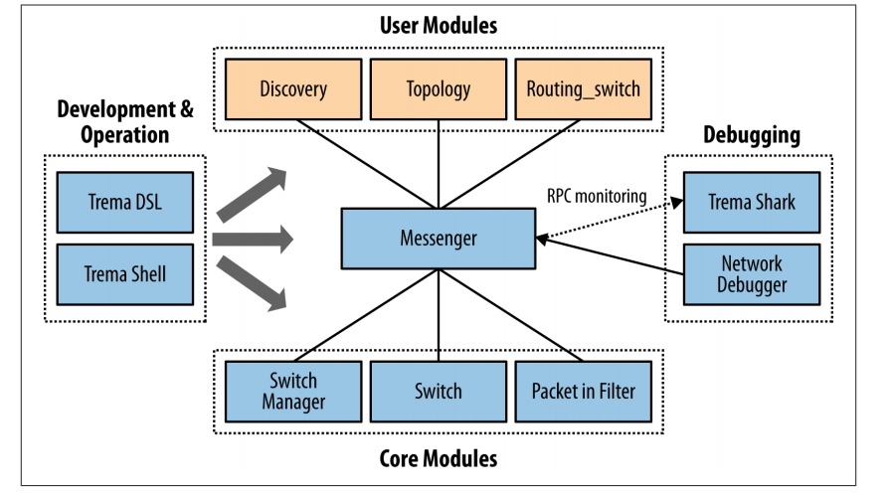
Trema
Trema core/user module relationships

Slide 26
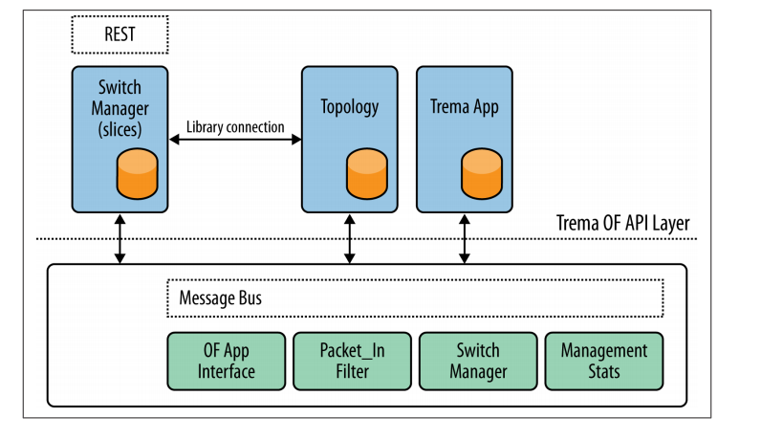
Trema Architecture

Slide 27
Ryu
Ryu is an open-source software framework that provides software components used for building Software-Defined Networking (SDN) applications.
Ryu is a component-based, open source (supported by NTT Labs) SDN controller implemented entirely in Python.
The Ryu messaging service does support components developed in other languages.
Components include an OpenFlow wire protocol support, event management, messaging, in-memory state management, application management, infrastructure services and a series of reusable libraries (e.g., NETCONF library, sFlow / Netflow library).
Ryu also supports a REST interface to its OpenFlow operations.
https://www.youtube.com/watch?v=5L4CnbVkeoU

Slide 28
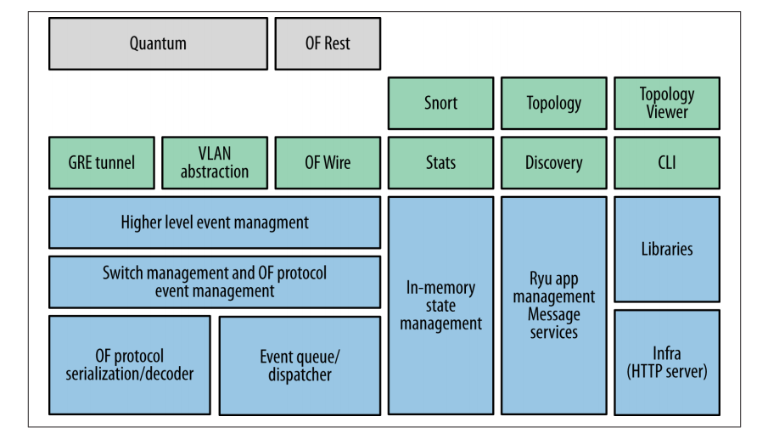
Ryu Architecture

Slide 29
Big Switch Networks/Floodlight
Floodlight is an open-source SDN controller maintained by Big Switch Networks company.
Floodlight is based on Beacon from Stanford University, an Apache-licensed, Java-based open source OpenFlow controller (non-OSGI).
The Floodlight core architecture is modular, with components including topology management, device management (MAC and IP tracking), path computation, infra‐ structure for web access (management), counter store (OpenFlow counters), and a generalized storage abstraction for state storage.
The core controller handles the basic functions of the SDN controller, such as managing connections to OpenFlow switches, processing OpenFlow messages, and maintaining the overall state of the network.
Floodlight provides a RESTful API that allows external applications to interact with the controller, retrieve network information, and issue commands.
Big Switch has been actively working on a data model compilation tool as an enhancement to the environment for both API publishing and data sharing.

Slide 30
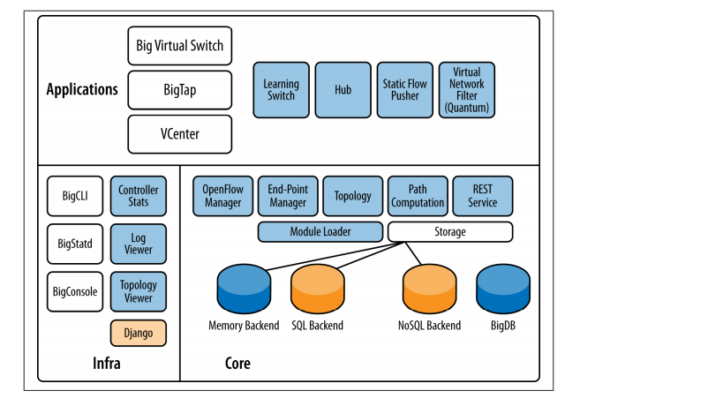
Big Switch Networks/Floodlight

